Slide 1
The HTTP Protocol
RES, Lecture 4
Olivier Liechti

Slide 2
Welcome to “the Web”

Slide 3

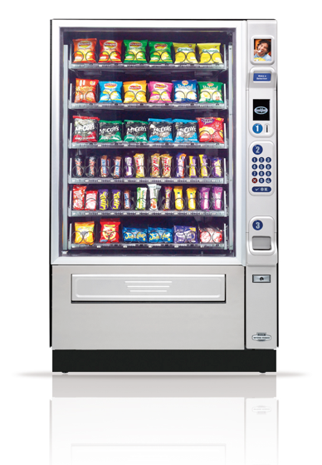
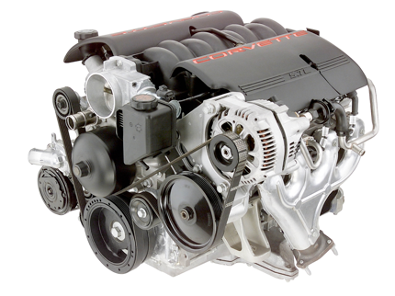
It started as an (hypertext) library...
... which is now blending with the
physical world
... which evolved to become an online application platform...

Slide 4





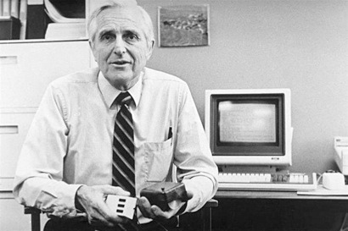





Slide 5
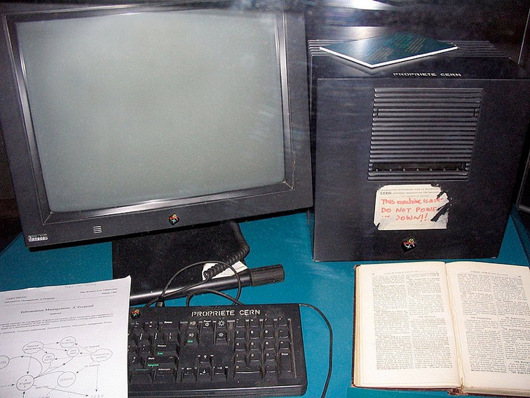
http://en.wikipedia.org/wiki/Image:First_Web_Server.jpg

Slide 6
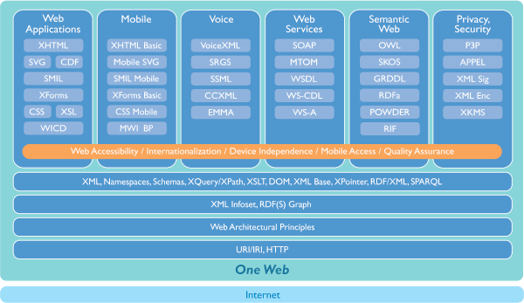
http://www.w3.org/Consortium/technology

Slide 7
What is HTTP?

Slide 8
The Hypertext Transfer Protocol (HTTP) is an application-level protocol for distributed, collaborative, hypermedia information systems.
It is a generic, stateless, protocol which can be used for many tasks beyond its use for hypertext, such as name servers and distributed object management systems, through extension of its request methods, error codes and headers [47].
A feature of HTTP is the typing and negotiation of data representation, allowing systems to be built independently of the data being transferred.

Slide 9
HTTP is one of the first two standards
of “the Web”
HTML
HTTP
Markup Language to
create hypertext documents
Protocol to transfer hypertext documents (and other content)

Slide 10
What is HTTP?
HyperText Transfer Protocol.
HTTP is an application-level protocol.
HTTP is used to transfer different types of payloads (HTML, XML, JSON, PNG, MP4, WAV, etc.) between clients and servers
Sometimes, the client issues a request to GET (i.e. obtain, fetch, download) a payload from a server.
Sometimes, the client issues a request to POST (i.e. send, upload) a payload to a server.
HTTP is built on top of TCP (the standard specifies that a server should accept requests on port 80).

Slide 11


HTTP request
HTTP reply
TCP connection
The browser is an HTTP client
The HTTP server accepts TCP connection requests (by default on port 80)

Slide 12
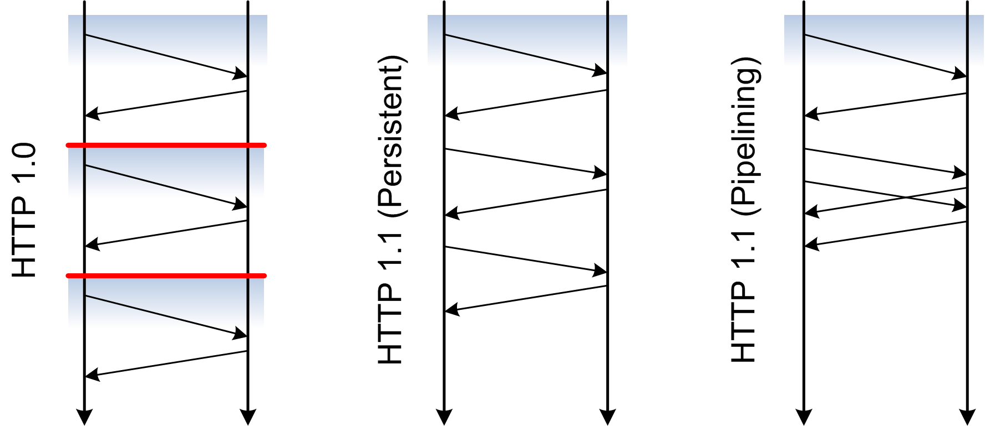
HTTP & TCP Connections
http://dret.net/lectures/web-fall07/foundations#(20)
http://www.apacheweek.com/features/http11

Slide 13



Looking at a Conversation...

Slide 14
GET / HTTP/1.1 CRLF
Host: www.nodejs.org CRLF
User-Agent: Mozilla/5.0 (Macintosh; Intel Mac OS X 10.8; rv:28.0) Gecko/20100101 Firefox/28.0 CRLF
Accept: text/html,application/xhtml+xml,application/xml;q=0.9,*/*;q=0.8 CRLF
Accept-Language: en-us,en;q=0.8,fr;q=0.5,fr-fr;q=0.3 CRLF
Accept-Encoding: gzip, deflate CRLF
Cookie: __utma=212211339.431073283.1392993818.1395308748.1395311696.27;
__utmz=212211339.1395311696.27.19.utmcsr=stackoverflow.com|utmccn=(referral)|utmcmd=referral
|utmcct=/questions/7776452/retrieving-a-list-of-network-interfaces-in-node-js- CRLF
Connection: keep-alive CRLF
CRLF
HTTP/1.1 200 OK CRLF
Server: nginx CRLF
Date: Sat, 05 Apr 2014 11:45:48 GMT CRLF
Content-Type: text/html CRLF
Content-Length: 6368 CRLF
Last-Modified: Tue, 18 Mar 2014 02:18:40 GMT CRLF
Connection: keep-alive CRLF
Accept-Ranges: bytes CRLF
CRLF
<!doctype html>
<html lang="en">
<head>
<meta charset="utf-8">
<link type="image/x-icon" rel="icon" href="favicon.ico">
<link type="image/x-icon" rel="shortcut icon" href="favicon.ico">
<link rel="stylesheet" href="pipe.css">
...

Slide 15
Request
GET / HTTP/1.1 CRLF
Host: www.nodejs.org CRLF
User-Agent: Mozilla/5.0 (Macintosh; Intel Mac OS X 10.8; rv:28.0) Gecko/20100101 Firefox/28.0 CRLF
Accept: text/html,application/xhtml+xml,application/xml;q=0.9,*/*;q=0.8 CRLF
Accept-Language: en-us,en;q=0.8,fr;q=0.5,fr-fr;q=0.3 CRLF
Accept-Encoding: gzip, deflate CRLF
Cookie: __utma=212211339.431073283.1392993818.1395308748.1395311696.27;
__utmz=212211339.1395311696.27.19.utmcsr=stackoverflow.com|utmccn=(referral)|utmcmd=referral
|utmcct=/questions/7776452/retrieving-a-list-of-network-interfaces-in-node-js- CRLF
Connection: keep-alive CRLF
CRLF
n header lines
no content (because it is a GET)
1 request line
1 empty line

Slide 16
Response
HTTP/1.1 200 OK CRLF
Server: nginx CRLF
Date: Sat, 05 Apr 2014 11:45:48 GMT CRLF
Content-Type: text/html CRLF
Content-Length: 6368 CRLF
Last-Modified: Tue, 18 Mar 2014 02:18:40 GMT CRLF
Connection: keep-alive CRLF
Accept-Ranges: bytes CRLF
CRLF
<!doctype html>
<html lang="en">
<head>
<meta charset="utf-8">
<link type="image/x-icon" rel="icon" href="favicon.ico">
<link type="image/x-icon" rel="shortcut icon" href="favicon.ico">
<link rel="stylesheet" href="pipe.css">
...
n header lines
1 status line
1 empty line
body

Slide 17
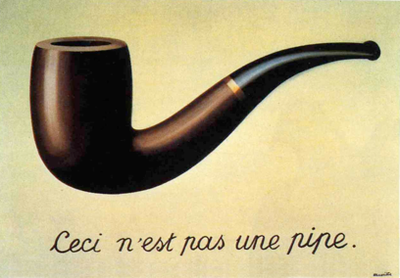
Resources, Resource Representations & Content Negotiation

Slide 18
Resource vs Resource Representation
The notion of resource is very generic and can represent anything...
An online document
A list of online documents
A stock quote updated in realtime
A vending machine
What is transferred is not the resource, but a representation of the resource
HTML representation, JSON representation, PNG representation
french representation, english representation, japanese representation
etc.

Slide 19
Content Negotiation
When making a request, the client specifies its abilities and preferences
media type: image, text, structured text?
media format: JSON, XML, etc.?
language: english, french, etc.
character encoding: UTF-8, ASCII, etc.
When answering the request, the server tries to do its best and indicates what it has been able to do
Special headers are used to support this process
Request: Accept, Accept-Charset, Accept-Language
Response: Content-Type, Content-Language

Slide 20
“This is what I am able to process, and these are my preferences...” (e.g. I am able to deal with plain text and XML, but I prefer JSON)”
“I am able to generate XML (not JSON), so you should be able to process this payload”

Slide 21
Protocol Syntax

Slide 22
HTTP Methods
GET
POST
PUT DELETE
(PATCH)

Slide 23
HTTP Methods & CRUD operations
POST
GET
PUT DELETE
(PATCH)
CREATE
READ
UPDATE DELETE
PARTIAL UPDATE

Slide 24
URI
http://www.heig-vd.ch?p1=v1&p2=v2
query string

Slide 25
Protocol Version
HTTP/1.0
HTTP/1.1
HTTP/2.0
QUIC

Slide 26
HTTP Requests
Full-Request = Request-Line ; Section 5.1
*( General-Header ; Section 4.3
| Request-Header ; Section 5.2
| Entity-Header ) ; Section 7.1
CRLF
[ Entity-Body ] ; Section 7.2
Request-Line = Method SP Request-URI SP HTTP-Version CRLF
Request-Header = Authorization ; Section 10.2
| From ; Section 10.8
| If-Modified-Since ; Section 10.9
| Referer ; Section 10.13
| User-Agent ; Section 10.15
Entity-Header = Allow ; Section 10.1
| Content-Encoding ; Section 10.3
| Content-Length ; Section 10.4
| Content-Type ; Section 10.5
| Expires ; Section 10.7
| Last-Modified ; Section 10.10
| extension-header

Slide 27
HTTP Responses
Full-Response = Status-Line ; Section 6.1
*( General-Header ; Section 4.3
| Response-Header ; Section 6.2
| Entity-Header ) ; Section 7.1
CRLF
[ Entity-Body ] ; Section 7.2
Status-Line = HTTP-Version SP Status-Code SP Reason-Phrase CRLF
Response-Header = Location ; Section 10.11
| Server ; Section 10.14
| WWW-Authenticate ; Section 10.16
Entity-Header = Allow ; Section 10.1
| Content-Encoding ; Section 10.3
| Content-Length ; Section 10.4
| Content-Type ; Section 10.5
| Expires ; Section 10.7
| Last-Modified ; Section 10.10
| extension-header

Slide 28
Status Codes
The first digit of the Status-Code defines the class of response. The
last two digits do not have any categorization role. There are 5
values for the first digit:
o 1xx: Informational - Not used, but reserved for future use
o 2xx: Success - The action was successfully received,
understood, and accepted.
o 3xx: Redirection - Further action must be taken in order to
complete the request
o 4xx: Client Error - The request contains bad syntax or cannot
be fulfilled
o 5xx: Server Error - The server failed to fulfill an apparently
valid request

Slide 29
Status Codes
Status-Code = "200" ; OK
| "201" ; Created
| "202" ; Accepted
| "204" ; No Content
| "301" ; Moved Permanently
| "302" ; Moved Temporarily
| "304" ; Not Modified
| "400" ; Bad Request
| "401" ; Unauthorized
| "403" ; Forbidden
| "404" ; Not Found
| "500" ; Internal Server Error
| "501" ; Not Implemented
| "502" ; Bad Gateway
| "503" ; Service Unavailable
| extension-code
extension-code = 3DIGIT
Reason-Phrase = *<TEXT, excluding CR, LF>

Slide 30
Parsing HTTP Messages

Slide 31
Process for Parsing HTTP Messages
Do NOT read characters, read bytes
At the beginning, you want to parse line by line
When consuming the body, you may be dealing with binary content
HTTP 1.0
On the client side, read until the connection is closed (end of stream reached).
On the server side, use the Content-Length header (for POST requests)
HTTP 1.1
Static content: use the Content-Length header
Dynamic content: use the chunked transfer encoding

Slide 32
Recommendations
Implement your own LineByLineInputStream
Remember the lecture about IOs & decorators?
You would like to have a readLine() method... but this one is available only in Reader classes
Implement your subclass of FilterInputStream and detect \r\n sequences
Add functionality incrementally, starting with a client
Start with HTTP 1.0 (read until close of connection)
Deal with Content-Length header
Deal with chunked transfer encoding

Slide 33
Training

Slide 34
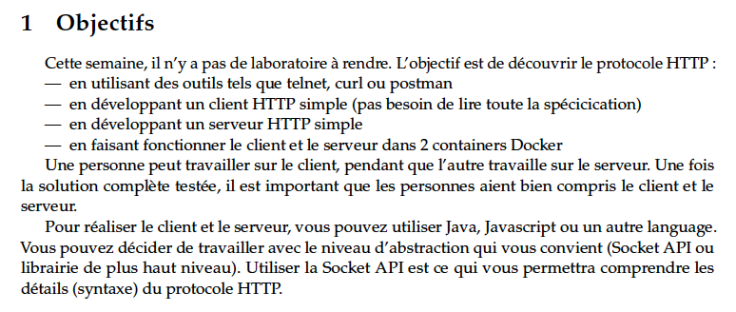

Slide 35
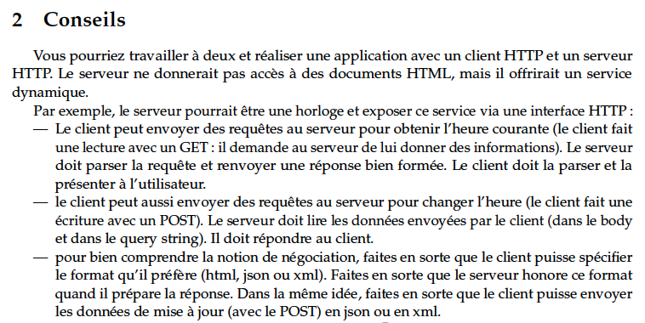

Slide 36
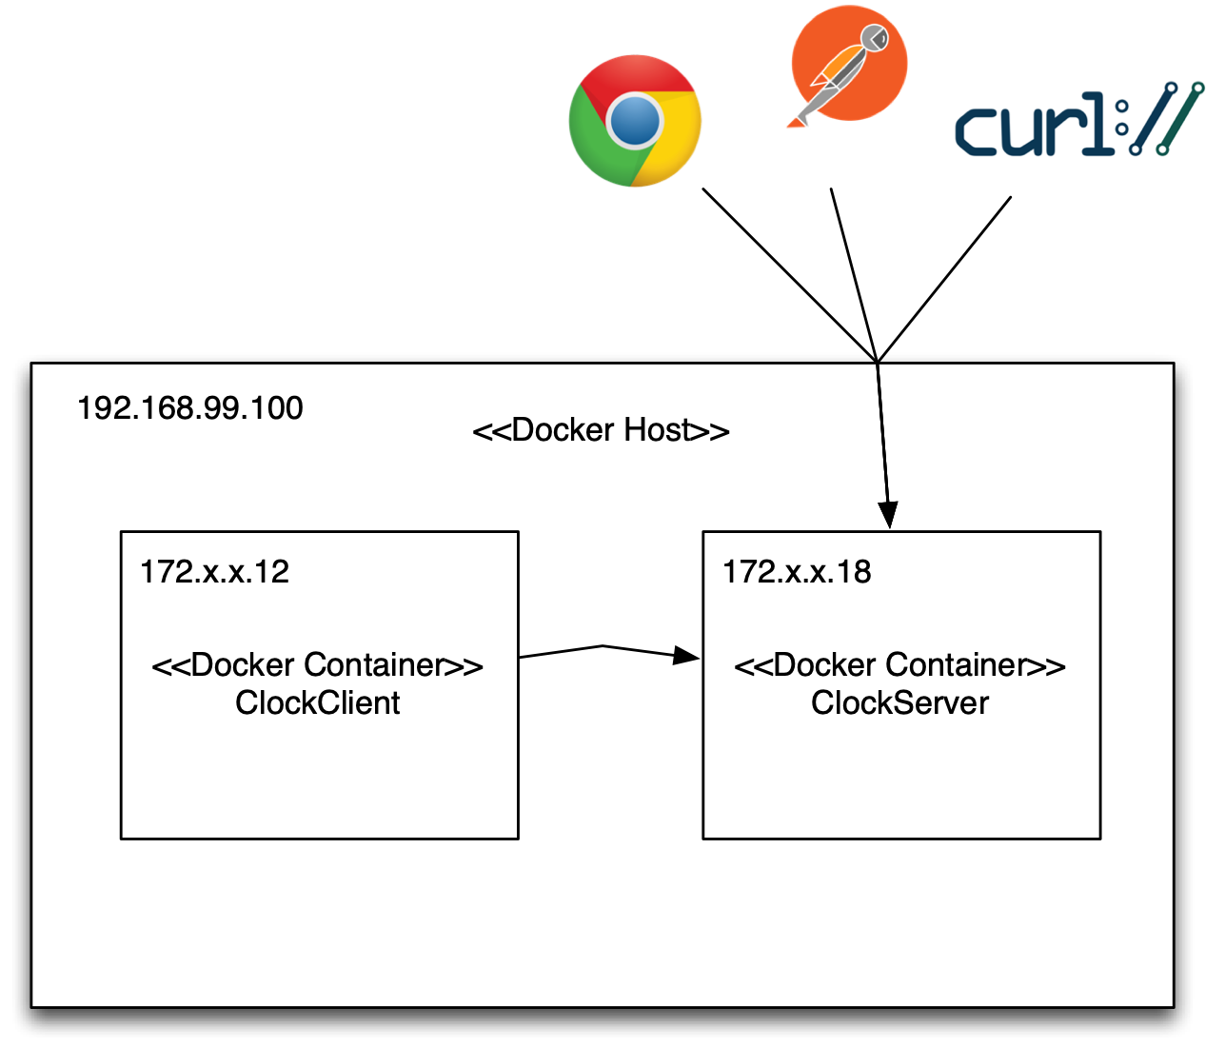

Slide 37
Useful tools for your
detective arsenal

Slide 38

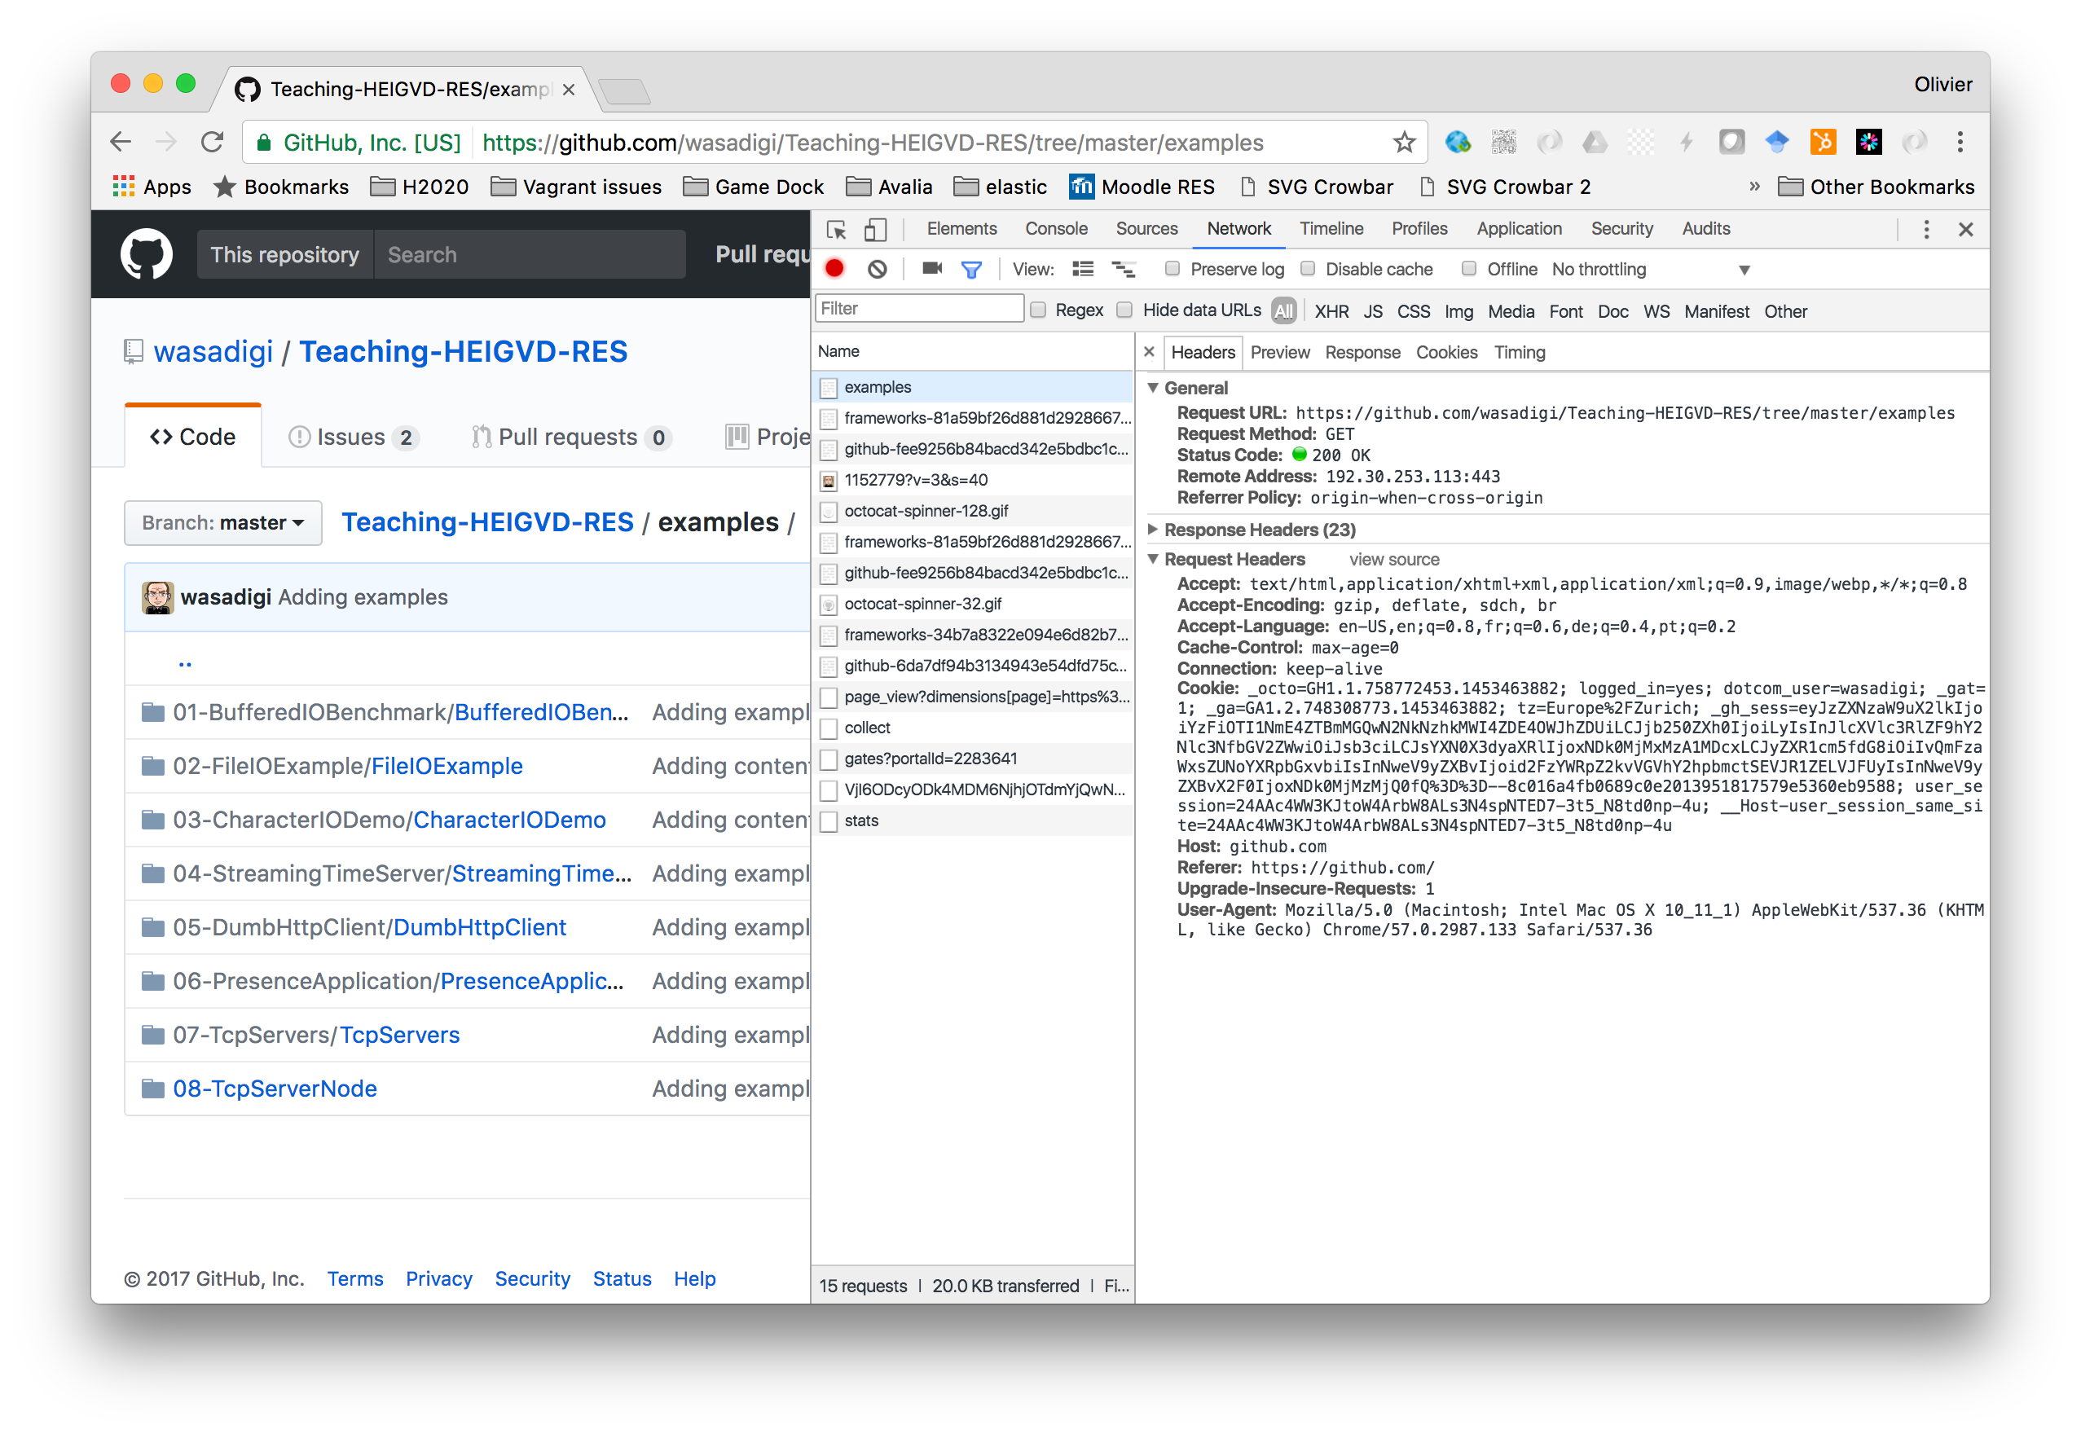
What can I do with it? | inspect request and response headers and body
Where do I find help? | https://developer.chrome.com/devtools
https://curl.haxx.se/

Slide 39

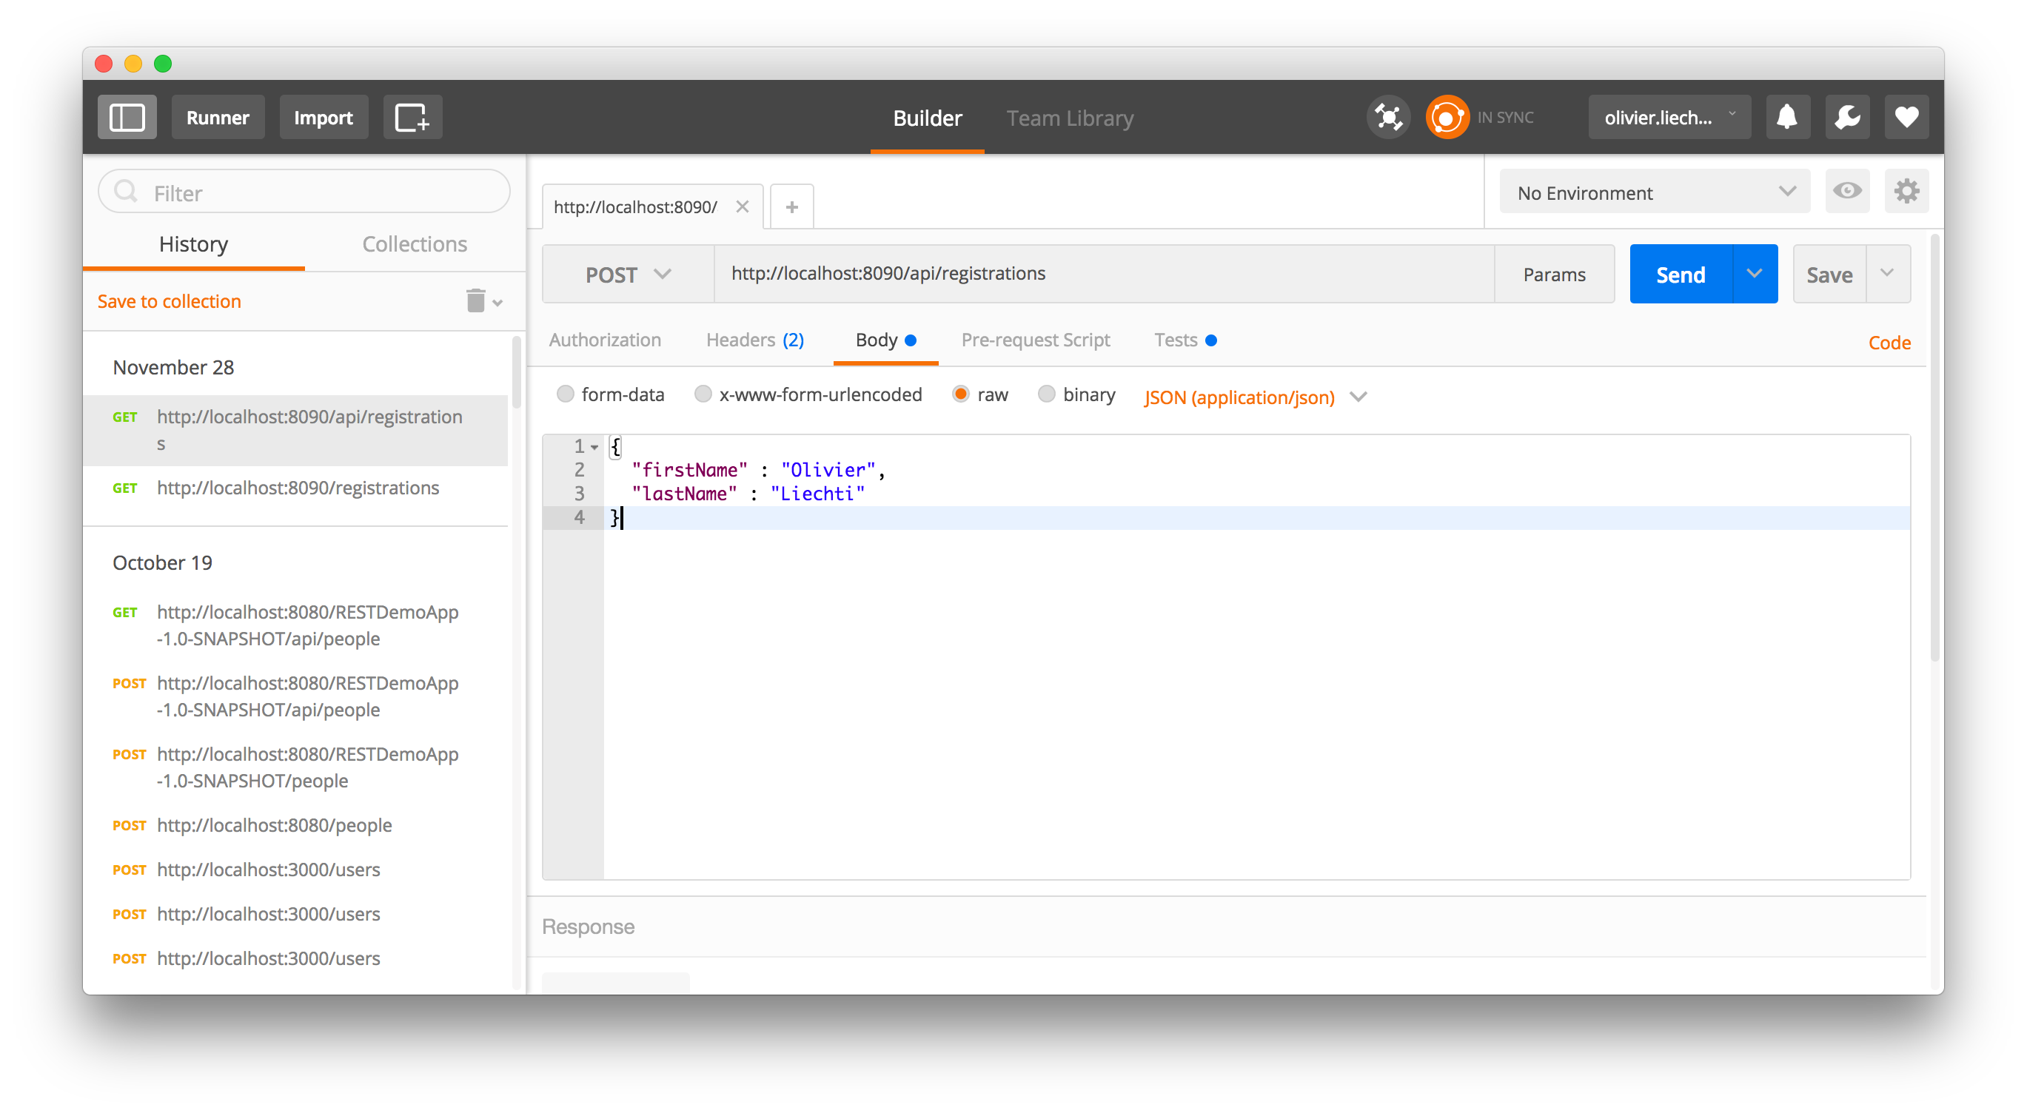
What can I do with it? | Send HTTP requests (also POST, also the body...)
Where do I find help? | https://www.getpostman.com/
https://curl.haxx.se/

Slide 40

What can I do with it? | send HTTP requests from terminal, inspect headers
Where do I find help? | https://curl.haxx.se/
How do I install it? | Package manager. You can use it in Docker.
https://curl.haxx.se/

Slide 41

Low level You know the drill, just implement the protocol syntax! | Socket s = new Socket(“www.heig-vd.ch”, 80); ...
Intermediate level (see Java tutorial) | URL url = new URL(“www.heig-vd.ch); URLConnection con = url.openConnection(); ....
High level (see http://hc.apache.org/ and don’t forget to add the dependency in your pom.xml) | Request.Get("http://somehost/") .connectTimeout(1000) .socketTimeout(1000) .execute().returnContent().asString();
https://curl.haxx.se/

Slide 42

Low level | var client = new net.Socket(); client.connect(80, ‘www.heig-vd.ch’, function() {...}); client.on('data', function(data) {...});
Intermediate level (see Java tutorial) | var http = require(‘http’); var options = {...}; var request = http.request(options, function(response) {...}); request.end();
High level (many npm modules: request, request-promise, superagent) | request .post('/api/pet') .send({ name: 'Manny', species: 'cat' }) .set('Accept', 'application/json') .end(function(err, res){ ... });
https://curl.haxx.se/

Slide 43
The HTTP Host Header

Slide 44
In the old days…
DNS
HTTP server with content for company a
public IP address
www.company-a.ch
193.134.218.45
HTTP server with content for company b
public IP address
www.company-b.ch
193.134.218.46
We would run out of IP addresses! A big web hosting provider would need thousands of public IPs.

Slide 45
Virtual hosting
DNS
HTTP server
virtual server for company a
www.company-a.ch
public IP address
193.134.218.45
virtual server for company b
www.company-b.ch
Ok… but when the HTTP server receives a request, how does it know if the user wants content A or content B?

Slide 46
HTTP 1.0
GET /index.html HTTP/1.0
Accept: text/html
With this information, impossible to know if the user wants to access virtual host A or B. We can only have one web site per IP address

Slide 47
HTTP 1.1
GET /index.html HTTP/1.0
Host: www.company-a.ch
Accept: text/html
GET /index.html HTTP/1.0
Host: www.company-b.ch
Accept: text/html
With HTTP 1.1, the Host header is mandatory and is used to solve this problem. The HTTP server can “forward” the request to the relevant virtual host

Slide 48
HTTP is a Stateless
Request-Reply Transfer Protocol

Slide 49
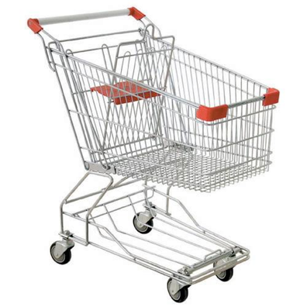

Stateless Protocol... but Stateful Applications!

Slide 50
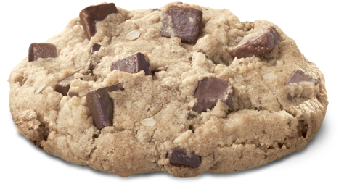
Managing State on Top of HTTP
Approach 1: move the state back-and-forth
One way to do it is to used hidden fields in HTML forms
Approach 2 (better): maintain state on the backend, transfer session IDs
One way to do it is to use parameters in the query string (security...)
One way is to use cookies

Slide 51
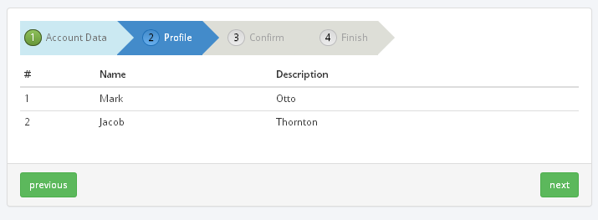
Passing State Back and Forth
C: Hello, I am new here. My name is Bob.
S: Welcome, let's have a chat [You told me that "My name is Bob"].
C: [My name is Bob]. What's the time?
S: Hi again Bob. It's 10:45 AM. [You told me that "My name is Bob". You asked me what is the time]

Slide 52
Passing Session ID Back and Forth
C: Hello, I am new here. My name is Bob.
S: Welcome Bob, let's have a chat. Your session id is 42.
C: My session id is 42. What's the time?
S: -- checking my notes… hum… ok, I found what I remember about session 42…
S: Hi again Bob. It's 10:45 AM.
C: My session id is 42. How do you do?
S: -- checking my notes… hum… ok, I found what I remember about session 42…
S: I am fine, Bob, thank you.
C: My session id is 42. How do you do?
S: -- checking my notes… hum… ok, I found what I remember about session 42…
S: I told you I am fine… are you stupid or what?
C: My session id is 42. If you take it like that, I am gone. Forever.
S: -- checking my notes… hum… ok, I found what I remember about session 42…
S: -- putting 42 file into trash…
S: Bye Bob.

Slide 53
Passing Session ID in URL
GET /login HTTP/1.1
Host: intra.heig-vd.ch
HTTP/1.1 302 Found
Location: http://intra.heig-vd.ch/home?sessionId=83939
GET /home?sessionId=83939 HTTP/1.1
Host: intra.heig-vd.ch
GET /page2?sessionId=83939 HTTP/1.1
Host: intra.heig-vd.ch
GET /logout?sessionId=83939 HTTP/1.1
Host: intra.heig-vd.ch

Slide 54
Passing Session ID in Cookies
The client sends a request to the server for the first time. It cannot send any cookie (it does not have any!).
The server understands that it is a new client. It creates a session and generates a unique session ID.
In the HTTP response, the server sends the unique session ID in a Set-Cookie header (“Here is a token... next time you come to see me, show me the token and I will recognize you!”).
The client keeps track of the cookie either in memory or on disk (it has a cookie store, i.e. a list of cookies sent by servers).
Before the client sends a second request to the server, it lookups the cookie store: “I am about to visit a server... did I receive any cookie from it?”. If yes, it sends the cookie in a Cookie header.

Slide 55
Passing Session ID in Cookies
The server sends a cookie (token):
The client sends it each time it returns to the server:
Set-Cookie: GAPSSESSID=4rm??????na; path=/; domain=gaps.heig-vd.ch
Cookie: GAPSSESSID=4rm??????na

Slide 56
Where does the server store the state?
What is transferred in the cookie is only a session ID, not session data (and BTW not user credentials!).
The data associated to the session typically includes the user identity (and roles), the previous actions performed by the user, the preferences, etc.
This data can be stored in various places. Where you store it can have a big impact on performance, scalability and fault-tolerance. There is no universal “best solution” - the choice depends on many factors.
Choice 1: store everything in the DB. One advantage is that if a web server crashes, it does not bring down the state. One disadvantage is that performance may
Choice 2: keep in the RAM of the web server. One advantage is the performance. One disadvantage is that you have to use sticky sessions. Another disadvantage is that RAM consumption could be high.
Choice 3: use a distributed caching layer (e.g. redis, memcached). One advantage is fault tolerance and scalability. One disadvantage is higher complexity and cost.

